Slide 1
Chapter 27
HTTP and WWW

Slide 2
27.1 HTTP
Transaction
Request Message
Response Message
Headers

Slide 3
Note:
HTTP uses the services of TCP on well-known port 80.

Slide 4
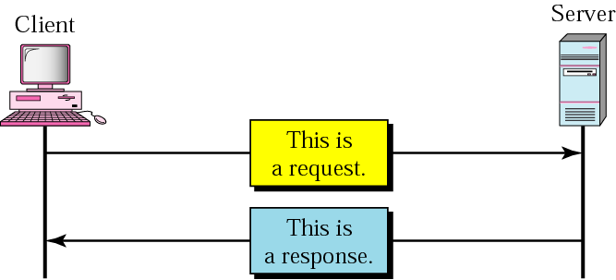
Figure 27.1 HTTP transaction

Slide 5
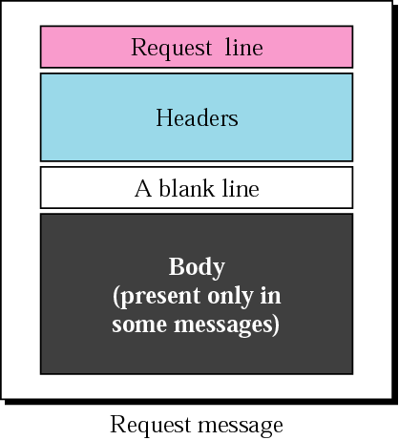
Figure 27.2 Request message

Slide 6
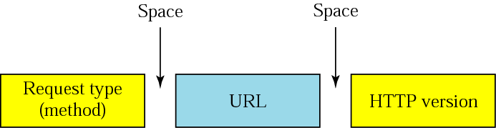
Figure 27.3 Request line

Slide 7
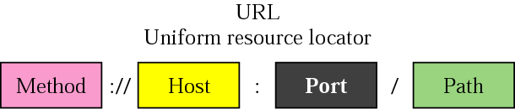
Figure 27.4 URL
http
https
ftp
…
:// www.example.com:2030/test/hello.html
예제
GET http://google.com/index.html HTTP/1.1

Slide 8
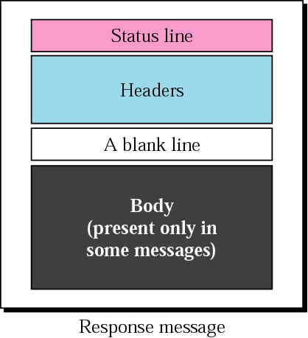
Figure 27.5 Response message

Slide 9
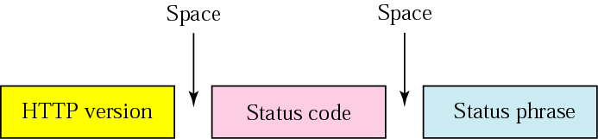
Figure 27.6 Status line

Slide 10
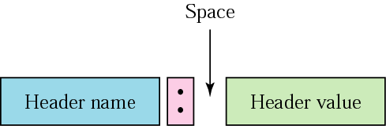
Figure 27.7 Header format
예제
Content-Length: 168

Slide 11
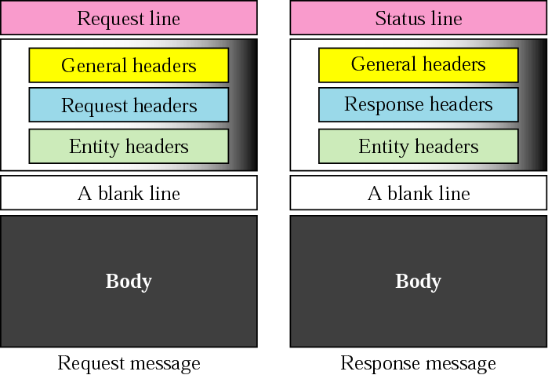
Figure 27.8 Headers

Slide 12
Example 1
This example retrieves a document. We use the GET method to retrieve an image with the path /usr/bin/image1. The request line shows the method (GET), the URL, and the HTTP version (1.1). The header has two lines that show that the client can accept images in GIF and JPEG format. The request does not have a body. The response message contains the status line and four lines of header. The header lines define the date, server, MIME version, and length of the document. The body of the document follows the header (see Fig. 27.9, next slide).

Slide 13
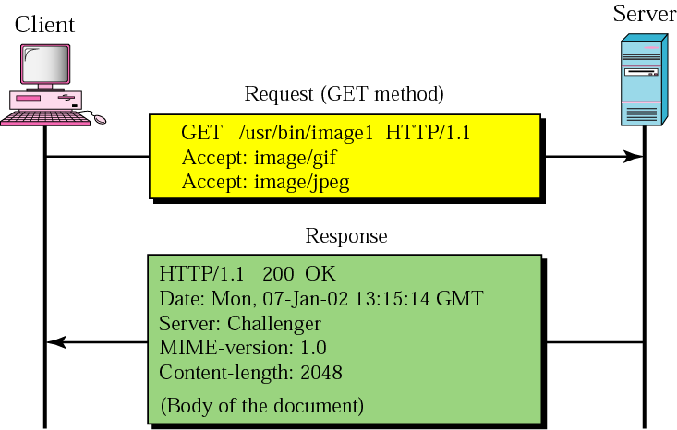
Figure 27.9 Example 1

Slide 14
Persistent vs. non-persistent
Non-persistent connection이란?
접속한 클라이언트 연결에 대한 응답을 보낸뒤 바로 끊음
서버는 클라이언트가 이전에 어떤 요청을 했었는지 정보 유지하지 않음
서버 로드가 줄어듦
서버 데이터가 한번에 준비되는 것이 아니라 시간을 두고 준비되는 경우 모든 데이터가 준비될 때 까지＂지연” 문제 발생
Persistent connection이란?
접속한 클라이언트 연결을 응답을 보낸 뒤에도 계속 “유지＂ 하는 것

Slide 15
Note:
HTTP version 1.1 specifies a persistent connection by default.

